Slide 1
Porting to Chrome
Internship Report-Out
Nicolas Langley
SSG-DRD-VCE

Slide 2
Presentation OUTLINE
Why Chrome?
Native Client Overview
GLBenchmark Overview
Porting Process
Major Challenges
Results and Performance
Conclusion

Slide 3

A bit about me…
Native of British Columbia, Canada
Interested in Computer Graphics, Games and Language
B.S. in Computer Science with Minor in Linguistics from McGill University in Montreal, Canada
Working on M.S. in Computer Science at University of California – Los Angeles
Second internship with Intel – previously worked on Beacon Mountain (now INDE) in SSG-DPD-PCI (Performance Client Integration)

Slide 4
Presentation overview
Intern project was to explore Google Native Client to deliver high performance graphical programs within Chrome (and Chrome OS)
Look at Google Native Client and see how it enables native C/C++ code to run in the browser
Explore the porting process from a traditional Windows application (GlBenchmark) to Chrome – examined pitfalls and performance

Slide 5
Presentation OUTLINE
Why Chrome?
Native Client Overview
GLBenchmark Overview
Porting Process
Major Challenges
Results and Performance
Conclusion

Slide 6
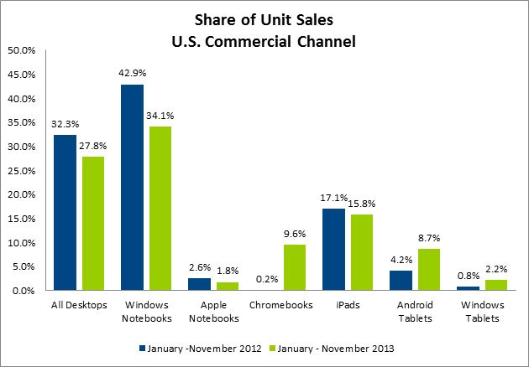
Why games on Chrome?
Google Chrome has 45% worldwide usage share of web browsers and is poised to become the most widely used web browser worldwide
Chrome OS is a standalone operating based on the Linux kernel that delivers a graphical interface based on the Google Chrome browser
Sales of Chromebooks (laptops running only Chrome OS) are on the rise – they accounted for 21% of commercial U.S. notebook sales in the business and education spaces

Slide 7
Why does intel care?
Intel processors power over 70% of available Chromebooks
Gaming is garnering interest across a wider range of devices
It is important to deliver competitive performance on Chromebooks with the release of more ARM-based models
Nvidia has partnered with Acer and is releasing a Chromebook using it’s high performance Tegra K1 chip
Understanding how games are developed for Chrome and how they perform is key

Slide 8
Presentation OUTLINE
Why Chrome?
Native Client Overview
GLBenchmark Overview
Porting Process
Major Challenges
Results and Performance
Conclusion

Slide 9
Enter Native Client…
Google Native Client (NaCl) is a sandboxing technology that allows for the execution of a subset of native C/C++ code securely within the browser
This allows native code to be safely run from a web browser independent of user variables such as operating system
NaCl supports OpenGL ES 2.0, sandboxed local file storage, dynamic loading and a host of other system features using the Google-supplied Pepper API
It provides a method to run C/C++ code in the browser with (ideally) the lowest performance penalty (vs. emscripten, asm.js, etc.)

Slide 10
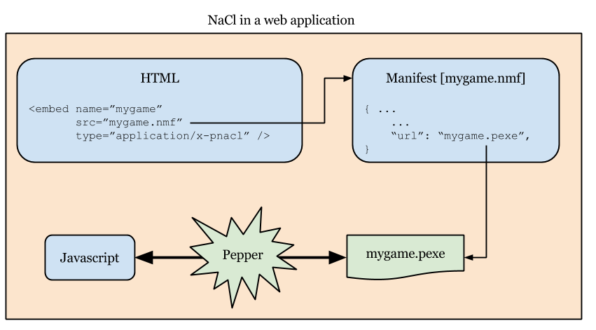
Structure of a Nacl Application
A NaCl ‘module’ is embedded within an HTML page and can interact with the user and other web technologies using Javascript
The components that comprise a NaCl application are the following:
HTML file
Javascript file
NaCl manifest (.nmf)
C/C++ code compiled into a NaCl module

Slide 11
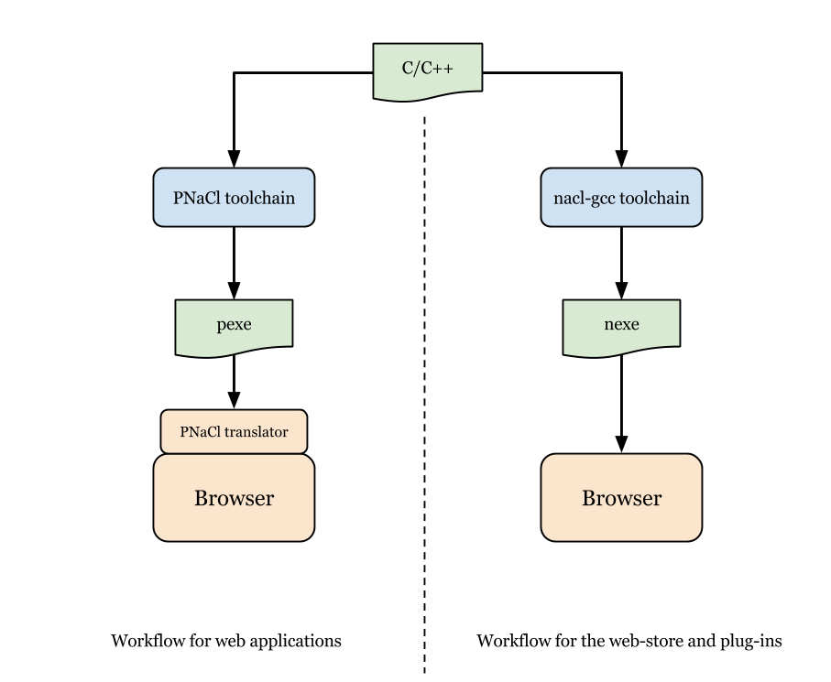
Pnacl and nacl toolchains
The compiled module is in .pexe or .nexe form depending on the toolchain used
A NaCl manifest file specifies the module which is then loaded by the webpage
A PNaCl module (.pexe) is native code compiled down into a IR that is then translated into the required system architecture by Chrome when it runs. This allows it to run in a webpage.
Traditional NaCl modules are compiled to a system architecture and then distributed and are therefore can have restrictions – these are typically only available from the Chrome Web Store
Once the initial translation occurs for the PNaCl module, performance is expected to be equivalent to a traditional NaCl module

Slide 12
NACL Development tools
Google provides a NaCl SDK that includes the required toolchains for building a NaCl application
The SDK includes a specialized version of GDB for debugging
There is an optional Visual Studio 2010 plugin that allows for building and launching of the SDK debugger – only works in Visual Studio 2010!

Slide 13
Presentation OUTLINE
Why Chrome?
Native Client Overview
GLBenchmark Overview
Porting Process
Major Challenges
Results and Performance
Conclusion

Slide 14


Overview of Glbenchmark
GLBenchmark is a widely used graphical benchmark utility for measuring the performance of systems by running through a series of complex OpenGL-based scenes
Developed by Kishonti Ltd. and has support for most major platforms including Windows, Mac OS X, Android and iOS.
One of the most popular tests is the T-Rex scene:

Slide 15
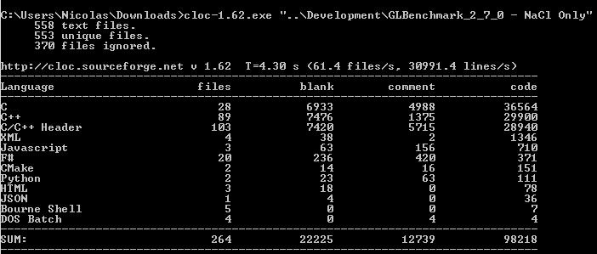
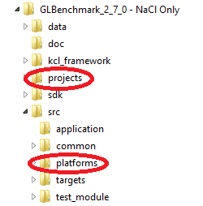
Overview of Glbenchmark - Cont.
The GLBenchmark application is a good example of a relatively large graphically intensive C++ application
Consists of ~98000 lines of code – circled folders are where platform specific code lives.
Platform specific code includes main application loop, running tests, loading of assets, and saving of results

Slide 16
Presentation OUTLINE
Why Chrome?
Native Client Overview
GLBenchmark Overview
Porting Process
Major Challenges
Results and Performance
Conclusion

Slide 17
The Porting process
We will go through what was required to port GLBenchmark to Chrome
Look at methods used to implement the required system features using Pepper API and Javascript for GLBenchmark.
The first step in porting GLBenchmark to NaCl is to convert the main loop and platform-specific code to conform to the conventions set in place by NaCl…

Slide 18
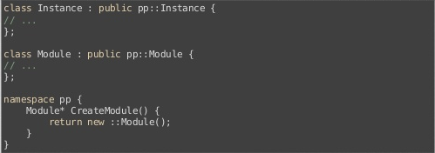
Converting To a nacl module
A NaCl module is the compiled native C/C++ code that interacts with the webpage using the Pepper API
Modules are represented by Instances that occur everytime a corresponding <embed> element is found in the HTML
To convert traditional C/C++ code into a NaCl module, a specific template must be followed:
The main functionality is placed within the Instance
System calls are then forced to be done through the Pepper API
While this is sold as a simple process, there are a number of large pitfalls to be aware of…

Slide 19
Presentation OUTLINE
Why Chrome?
Native Client Overview
GLBenchmark Overview
Porting Process
Major Challenges
Results and Performance
Conclusion

Slide 20
Problem 1 – EGL in NACl
NaCl supports OpenGL ES 2.0 through the Pepper API using the Graphics3D library
This abstracts most of the setup of the context from the developer while allowing access to the regular set of GL instructions
EGL is not present – Pepper API handles the native windowing
The absence of EGL within NaCl breaks many native applications that assume that EGL exists

Slide 21
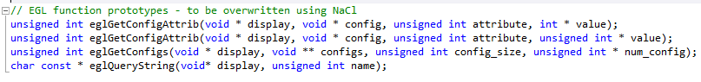
Solution – implement egl functions
Implement EGL functions (with dummy functionality) in order for application to run without modifying non platform-specific source
If actual EGL functionality is required, this will need to be implemented using the Pepper API (not required for GLBenchmark)
For the GLBenchmark application there were a limited number of EGL functions that are used – this is variable by application

Slide 22
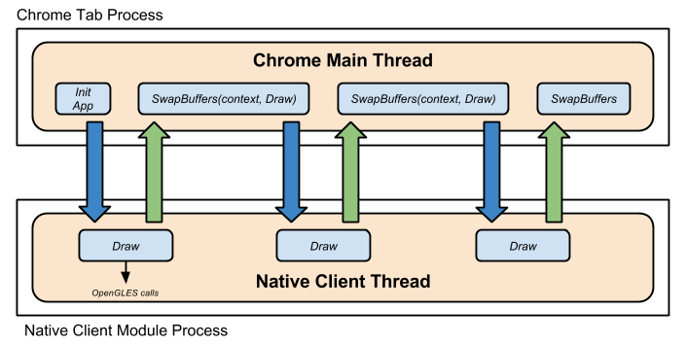
Problem 2 – Rendering in chrome
The NaCl rendering model is unique as the NaCl module runs as its own thread within the Chrome process
All rendering has to happen on the main Chrome thread and relies on a special SwapBuffers function – this function is non-blocking
Callbacks are passed to SwapBuffers to determine where to return to in the main NaCl thread
This causes trouble as many main application loops are not designed to follow a callback-based model

Slide 23
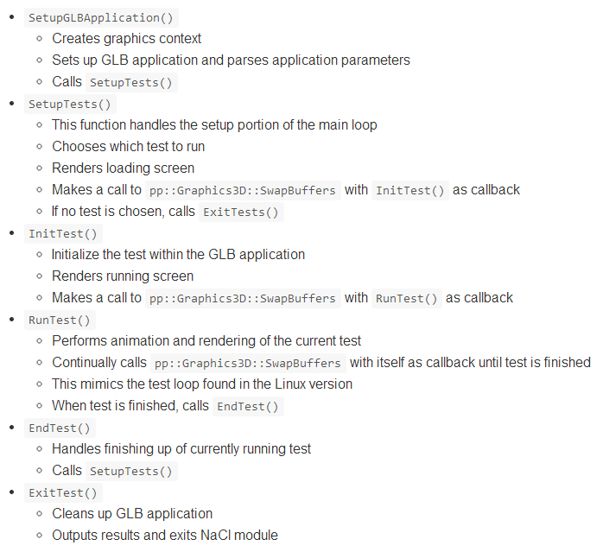
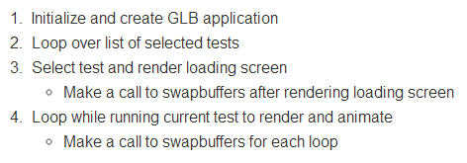
Solution – partition main loop
Break up the main application loop into smaller sub-functions that encapsulate specific functionality that can be passed as a callback to SwapBuffers

Slide 24
Problem 3 – file i/o
File I/O is integral to any graphically intensive application
Required to load textures and other assets as well as save user data
There is no access to the system file system – we are running from within the browser (i.e. a sandbox)

Slide 25
Solution – nacl io library
Google supplies non-blocking functions for File I/O using the Pepper API
But what if we want to do traditional blocking I/O (e.g. fopen, etc.)
Good news! NaCl includes the nacl_io library that allows this
nacl_io works by mounting the local sandboxed storage and reading from and writing to it
Bad news: there are restrictions placed on the calls made in the main NaCl thread

Slide 26
Problem 4 – main thread non-blocking
The main NaCl thread is non-blocking
This restriction makes it very difficult (impossible) to perform any File I/O or similar task that requires the main NaCl thread to block.
This restriction is placed in order to ensure the responsiveness of the webpage

Slide 27
Solution – create background thread
Create a background worker thread that can handle blocking calls and use it to perform any File I/O, etc.
GLBenchmark relies heavily on blocking calls (mainly File I/O) and so the entire application is run on a background thread
Chrome Main Thread
Native Client Thread
Init App
Setup
Worker Thread
Update Frame
SwapBuffers
Update Frame

Slide 28
Problem 5 – asset management
In order to perform File I/O, we first need to have the required assets
Not trivial as there is no access to the system file storage
We must move assets into HTML5 Persistent Storage or load them dynamically from a URL.

Slide 29
Solution – packaged assets and javascript
I choose to move all of the GLBenchmark assets to HTML5 Persistent Storage at the initial startup of the application
This is done by packaging the NaCl application as a Chrome extension and including the assets within the extension
Used Javascript and Chrome FileSystem API to copy assets
Assets are then accessible to NaCl module using nacl_io library and the HTML5 Persistent Storage
Chrome Thread
Copy Data
HTML5 Persistent Storage
NaCl Thread
Init App
Read Data

Slide 30
Presentation OUTLINE
Why Chrome?
Native Client Overview
GLBenchmark Overview
Porting Process
Major Challenges
Results and Performance
Conclusion

Slide 31
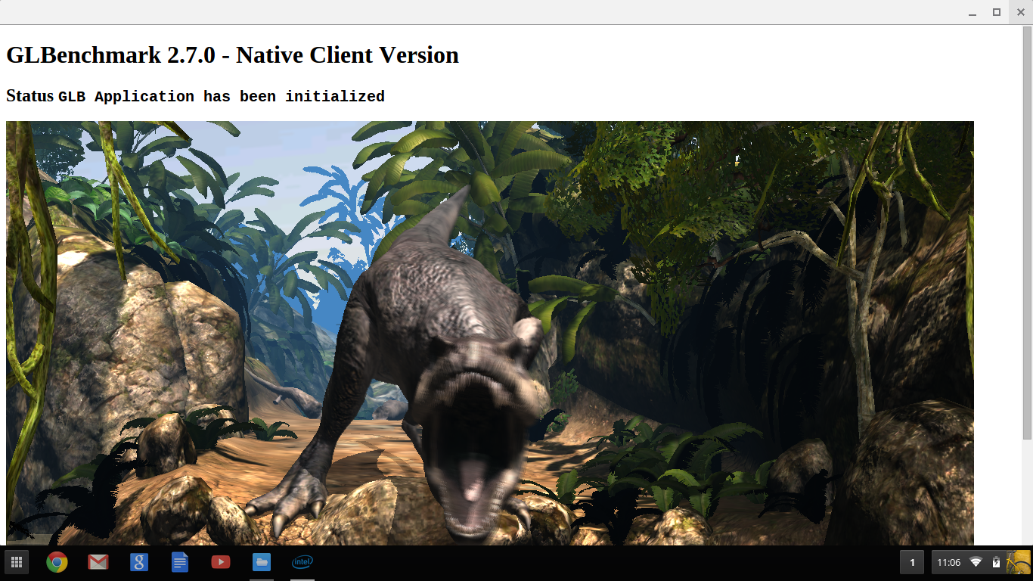
Result – GLBenchmark on Chrome os!

Slide 32
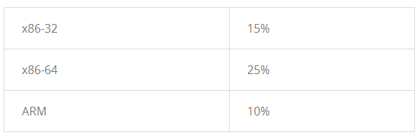
How does glbenchmark run?
Performance suffered quite a large penalty
There was a >25% performance hit when running the same GLBenchmark test within Chrome versus natively in Windows
Google has stated expected performance numbers that mirror that range:
GLBenchmark Test | Windows | Chrome
T-Rex HD Offscreen | 152 fps | 105 fps

Slide 33
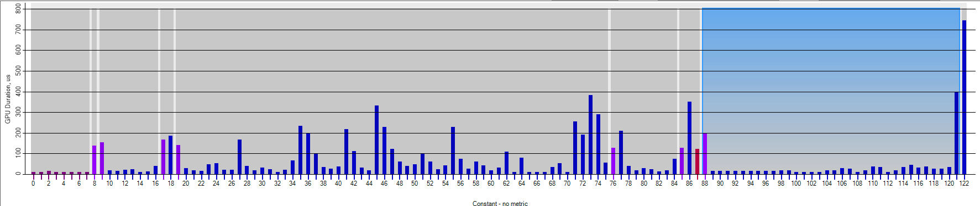
How does glbenchmark run? - Cont.
Some of the performance hit can be attributed to rendering and running within the Chrome process
Within the shown GPA frame analysis, approximately 23% of the render time is spent dedicated to Chrome.
Chrome Specific

Slide 34
Presentation OUTLINE
Why Chrome?
Native Client Overview
GLBenchmark Overview
Porting Process
Major Challenges
Results and Performance
Conclusion

Slide 35
Conclusion - impressions of Nacl
Google Native Client provides a viable method for running high performance graphical applications on Chrome OS and Chrome
The development tools are still immature and the documentation is spotty at best – there is a large learning curve
Most code is easily ported but there are some difficult areas – File I/O, Assets, Threading
If performance and development tools / workflow can be improved, could serve as a viable platform for running games and other high performance applications with relatively few modifications to existing source

Slide 36
Conclusion - What is next?
If I were to continue working on this project the roadmap would look like:
Analyze performance of GLBenchmark – compare to Windows and determine if penalty can be reduced
Port a larger codebase (e.g. Doom 3) to NaCl to work with a more traditional game loop and revise and test techniques and workflow
Establish BKM for input and audio (not required for GLBenchmark)
Provide a detailed roadmap for developers to follow when porting high performance applications to NaCl

